Slide 1
Slide Deck Overview
Each Bullet point references a Section in the Slide Deck.
Overview
Building a BOL from a Planned Movement Lifting – Graphical representation of data movement between the Planned Movement and BOL.
Planned Movement to BOL Mapping – Shows which data should be copied from the Planned movement to the BOL, as well as some other additional processing requirements.
Use Cases – BOLs have been generated for the Use Cases presented in the “PM Documentation” Directory. The rules outlined in this document have been applied in the BOL generation process. All Planned Movements, Responses, and BOLs were generated through the use of the Planned Movement XML Generator spreadsheet. Feel free to use the spreadsheet to generate your own sample input files.
Notes:
Change Slide Deck Overview

Slide 2
Overview
This Document contains the BOL Processing Requirements for Lifting against a Planned Movement Document. The Planned Movement Document contains Reference data vital to electronically processing BOL data. The following slides show what data should be moved from the Planned Movement into the BOL to help Back Office systems process BOL data.

Slide 3
BOL Building
This section discusses what should be copied from the Planned Movement to the BOL. The first couple Slides show the structure of the planned Movement and BOL, the following slide shows the sections to be copied. Subsequent slides have the Xpath Mappings showing which sections/data should be copied from the Planned Movement to the BOL.

Slide 4
Planned Movement Structure
Main Document Header Elements
Shipments Only
Header
(Basic Envelop)
Movement Type, DocumentID, Document Originator
Delivery Line Item Level for Shipments
Header References
Documents
Document
Plant/Product/Qty
Parties
Document
Document LI
Delivery Plan
Shipment
Detail References
LoadPlan
Transport Company
Configured Vehicle/Engine
Plant/Product/Qty
References
Agent
LoadingParts/
Compartment
Detail References

Slide 5
BOL Structure Overview
Header
(Basic Envelop)
Transport
Company
Posting
PostingRef
Driver
Posting
Document References
MOT
Header
References
Loading Parts
Loading Part ID
Loading Parts
Parties
Compartment
Plant
Shipment
Product
Transport
Measurements & Recipe
Detail
References

Slide 6
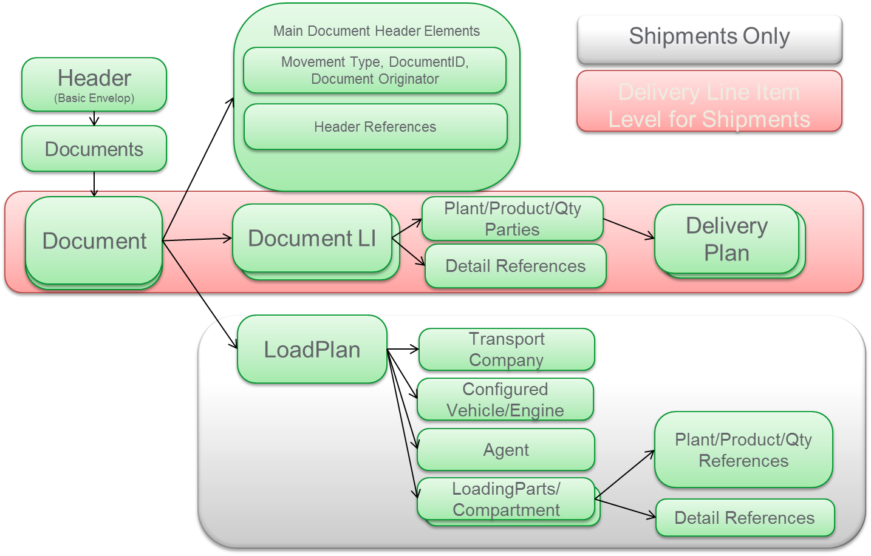
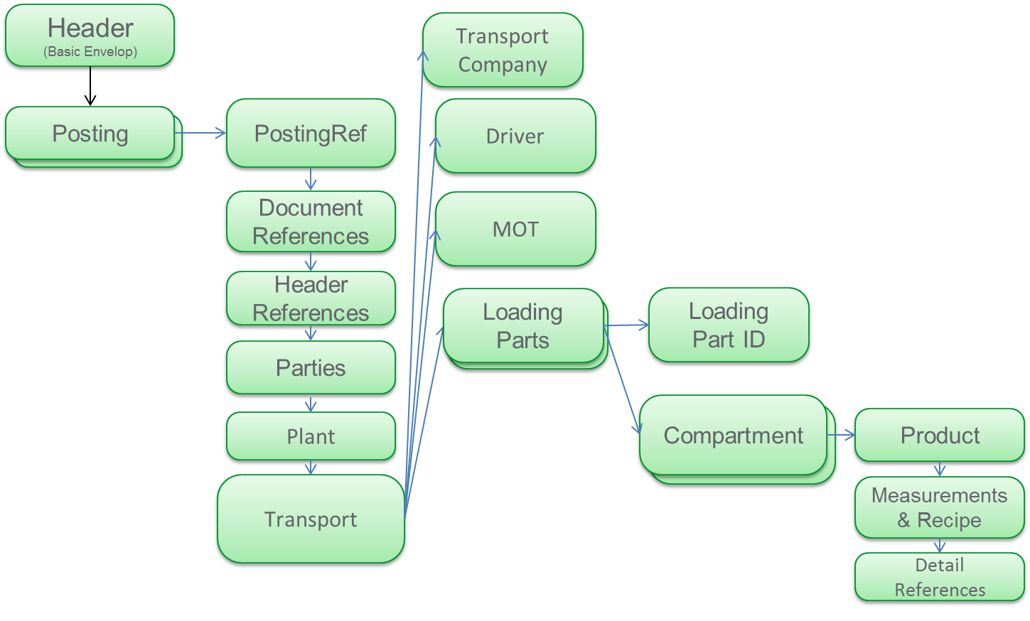
Mapping The PM to the BOL
Planned Movement | BOL
Red Arrow = Required mapping (see next Page)
Green Arrow = Map Document LI Refs or LoadPlan Refs
(LoadPlan only valid for Shipments)
TAS should place the MovementType (see translation Table)/DocumentId/
DocumentOrginator and LI details on the BOL in the Reference section then copy
all references associated with that LI to that Compartment.

Slide 7
PM to BOL Mapping
Field Name | Planned Movement Xpath | BOL XPath | Action
Header References | pidx:PIDXPlannedMovement/pidx:Documents/pidx:Document/pidx:DocumentHeader/pidx:References | pidx:LoadingDeliveryReceipt/pidx:Body/pidx:Posting/pidx:References | Copy All Data Regardless of MovementType (Red Arrow)
Movement Type To Document Reference Type | pidx:PIDXPlannedMovement/pidx:Documents/pidx:Document/pidx:DocumentHeader/pidx:MovementType | pidx:LoadingDeliveryReceipt/pidx:Body/pidx:Posting/pidx:DocumentReference/pidx:DocumentReferenceType | Translation Required
Document Originator | pidx:PIDXPlannedMovement/pidx:Documents/pidx:Document/pidx:DocumentHeader/pidx:DocumentOriginator | pidx:LoadingDeliveryReceipt/pidx:Body/pidx:Posting/pidx:DocumentReference/pidx:DocumentOriginator | Copy Element
Document ID | pidx:PIDXPlannedMovement/pidx:Documents/pidx:Document/pidx:DocumentHeader/pidx:DocumentIdentifer | pidx:LoadingDeliveryReceipt/pidx:Body/pidx:Posting/pidx:DocumentReference/pidx:DocumentIdentifier | Copy Element
*Detail References | pidx:PIDXPlannedMovement/pidx:Documents/pidx:Document/pidx:DocumentLineItems/pidx:DocumentLineItem/pidx:DetailReferences/pidx:Reference | pidx:LoadingDeliveryReceipt/pidx:Body/pidx:Posting/pidx:Transport/pidx:LoadingParts/pidx:LoadingPart/pidx:Compartments/pidx:Compartment/pidx:Reference | Copy PM LI References Lifted against to BOL
*LoadPlan References for Shipments | pidx:PIDXPlannedMovement/pidx:Documents/pidx:Document/pidx:LoadPlan/pidx:LoadingPlanParts/pidx:LoadingPlanPart/pidx:LoadCompartments/pidx:LoadCompartment/pidx:DetailReferences/pidx:Reference | pidx:LoadingDeliveryReceipt/pidx:Body/pidx:Posting/pidx:Transport/pidx:LoadingParts/pidx:LoadingPart/pidx:Compartments/pidx:Compartment/pidx:Reference | Copy Reference at compartment Level, if lifting as planned
*For Shipments if References are listed in LoadPlan, then copy the references
from the LoadPlan, otherwise copy the references from the Document LI section. For
shipments the LoadPlan References should be filled in so you know which product/quantities
where loaded for each Delivery, so you can bill correctly.

Slide 8
PM To BOL Mapping Continued
Field Name | Planned Movement Xpath | BOL XPath | Action
Detail Reference Additional Ref | Copy DocumentOriginator, MovementType* Document ID, LI Associated with Lifting to BOL | pidx:LoadingDeliveryReceipt/pidx:Body/pidx:Posting/pidx:Transport/pidx:LoadingParts/pidx:LoadingPart/pidx:Compartments/pidx:Compartment/pidx:Reference/pidx:ReferenceOwner pidx:LoadingDeliveryReceipt/pidx:Body/pidx:Posting/pidx:Transport/pidx:LoadingParts/pidx:LoadingPart/pidx:Compartments/pidx:Compartment/pidx:Reference/pidx:ReferenceQualifier pidx:LoadingDeliveryReceipt/pidx:Body/pidx:Posting/pidx:Transport/pidx:LoadingParts/pidx:LoadingPart/pidx:Compartments/pidx:Compartment/pidx:Reference/pidx:ReferenceIdentifier pidx:LoadingDeliveryReceipt/pidx:Body/pidx:Posting/pidx:Transport/pidx:LoadingParts/pidx:LoadingPart/pidx:Compartments/pidx:Compartment/pidx:Reference/pidx:ReferenceItem | Translation Required on MovemenType to References The references form the LI should be copied to the detail references as well( see previous slide)

Slide 9
Special Considerations/Exceptions
TASLoadID/LoadID/3rdPartyLoadID – Only the LoadID entered in at the TERMINAL should be placed on the BOL. ALL LoadIDs should not be copied into outbound BOL. If there is more than one 3rdPartyLoadID per line item then do not include the 3rdPartyLoadID.
MovementType to DocumentType Transalations
MovementType(PM) | DocumentReferenceType (BOL)
Contract | SalesContract
LoadID | LoadID
Nomination | Nomination
Order | SalesOrder
Shipment | Shipment

Slide 10
Applying the Rules Comments
To see how this functionality has been implemented, go to the PM Documentation directory. Review the Use Cases for the Planned Movements and look at the BOL Worksheet in the XML Generation Tool for each of the use cases. Look at the XML Documents generated (either in the Spreadsheet or in the directory). Change the Reference Data in the PM or Shipments and see how it gets copied over to the BOL tab. Note how the Document Line Items on the BOL Details lines links all the data to Either the Shipment or Planned Movement Sheets. Note how the Header Reference get copied into the BOL if present. Note the translations performed from Contract to SalesContract when the BOL is generated. Play around with the Spreadsheet and familiarize yourself with out the contents works between the PM/Shipment sheets and the BOL. This is basically the logic you will have to build into the loading process when the Driver is lifting from a Planned Movement.

